Slide 1
Design and Implementation of a DFA for String Recognition
By: Dominick Girard

Slide 2
Overview
What's a DFA
My DFA
Accepted and Rejected Strings
Java Implementation

Slide 3
DFA (Deterministic Finite Automaton)
Definition: A DFA is a model of computation that consists of a finite number of states, transitions between these states, one start state, and a set of accept states.
Deterministic: Each state has exactly one transition for each symbol in the alphabet, ensuring a single possible path for a given input string.
States: The finite set of conditions or configurations that the DFA can be in.
Alphabet: A finite set of symbols that the DFA can read as input.
Transitions: Rules that determine the next state based on the current state and the input symbol.
Start State: The state where the computation begins.
Accept States: States that determine if the input string is accepted by the DFA upon completion of processing.
Computation: The DFA reads a string of symbols from the alphabet, transitioning through states according to its rules, and the string is accepted if it ends in an accept state.

Slide 4
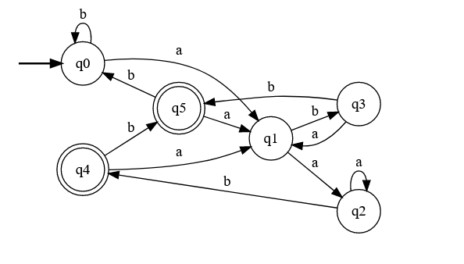
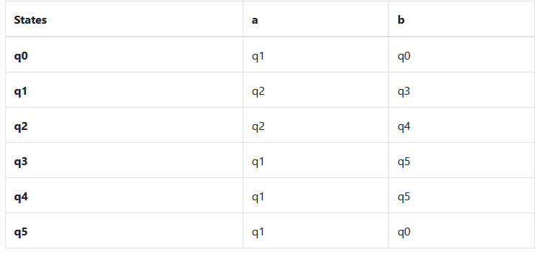
Regular Language
My DFA
(a U b)* a(a U b)b
Transition Table

Slide 5
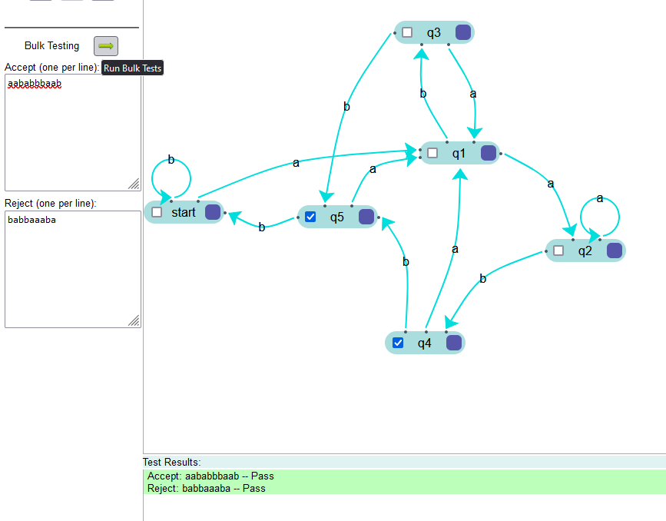
Accepted String
Rejected String
aababbbaab
babbaaaba

Slide 6
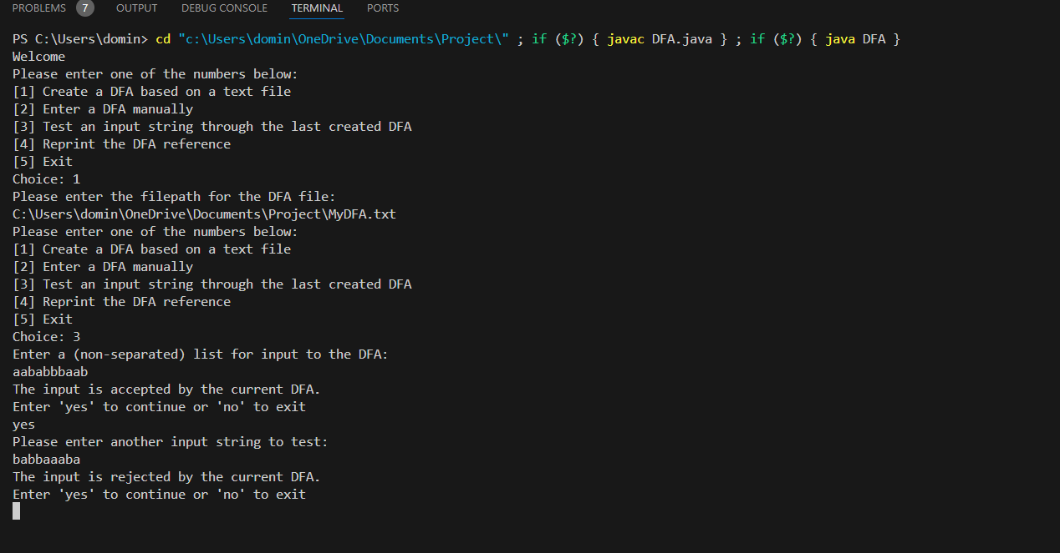
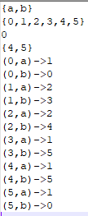
Java Implementation
DFA text file

